Slide 1
Take Better Notes
Tomas Rivera Center for Student Success

Slide 2
WHY TAKE NOTES?
Taking notes helps students to concentrate in class.
Taking notes develops a sense of listening, allowing the reader to recognize main ideas.
Makes student an active part of the learning process rather than a passive listener.
Helps prepare for the exams, quizzes.

Slide 3
WHY TAKE NOTES?
Notes often contain info that generally cannot be found else where (i.e textbooks).
Notes are often a valuable clue for what instructor thinks is important.
Taking notes in class means that you are working the information and processing in every day

Slide 4
TAKING NOTES IN CLASS
Before the lecture begins:
Arrive to class on time.
Sit as near to the front of the room as possible to eliminate distractions.
Be sure to have read assigned readings before coming to class.
Make a list of questions from the readings to ask the professor in class.
Review your notes from previous lecture.

Slide 5
TAKING NOTES IN CLASS
During the lecture:
Have your paper & pencil or pen ready.
Attend all of every class.
Copy everything that instructor writes on the board, especially the outline.
Be an active listener and pay attention to instructor’s verbal cues. His choice of words might indicate the importance of the information. For example.., most importantly.., the result is.., finally etc.
Use your own words in summarizing what instructor is saying.

Slide 6
TAKING NOTES IN CLASS
To write a little faster use abbreviations & symbols to record the information.
W/ with
W/O without
Page
< less than
b/4 before
= equals
% percent
Vs versus
C/o care of

Slide 7
TAKING NOTES IN CLASS
Be clear & complete in your notes. Leave a (?) by info that is unclear. Later go back & check with your instructor.
After the lecture:
Revise and/or rewrite the notes as quickly as possible, preferably the same day of the lecture.
Coordinate readings and the lecture notes.
Review notes at least once a week & also review before next lecture.

Slide 8
Using a tape recorder
If permitted, tape recorders can be used in class to record the lecture. Unless you have a learning disability, take notes just as you would if the tape recorder were not there. Later, you can listen to the tapes to clarify your notes and help you remember important ideas.

Slide 9
NOTE TAKING FOR MATH
Write down the title of the lesson.
Write down the math problem & each step in solution using math symbols.
Next to each step write down in your own words exactly what you are doing. (This is easier to do when you are revising your notes).
Ask instructor about the part of the problems you don’t understand.
Do ALL homework problems and not just some of them!

Slide 10
CORNELL METHOD OF NOTE TAKING
Recall
Column Notes Column

Slide 11
Cornell Notes
Divide the paper vertically by drawing a line from top to bottom about 2” from the left side of the page.
2. Write on one side of page only. Write student name, course, date & page number at top of each page.
3. During lecture, record the main ideas & concepts on the right side of the page (notes column).

Slide 14
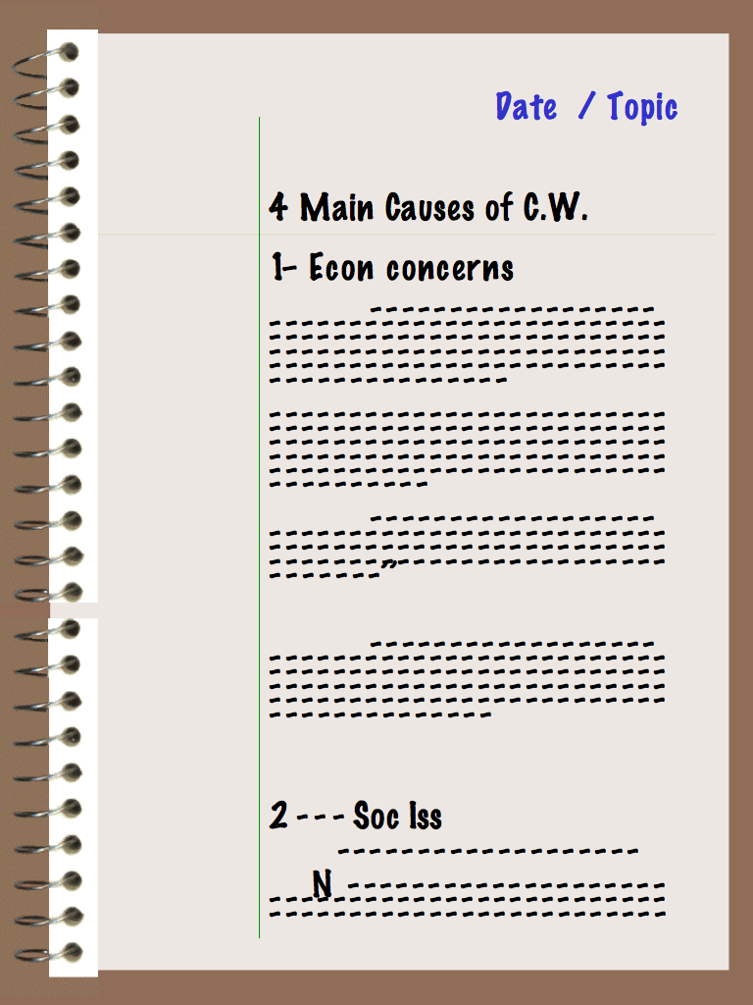

Slide 15
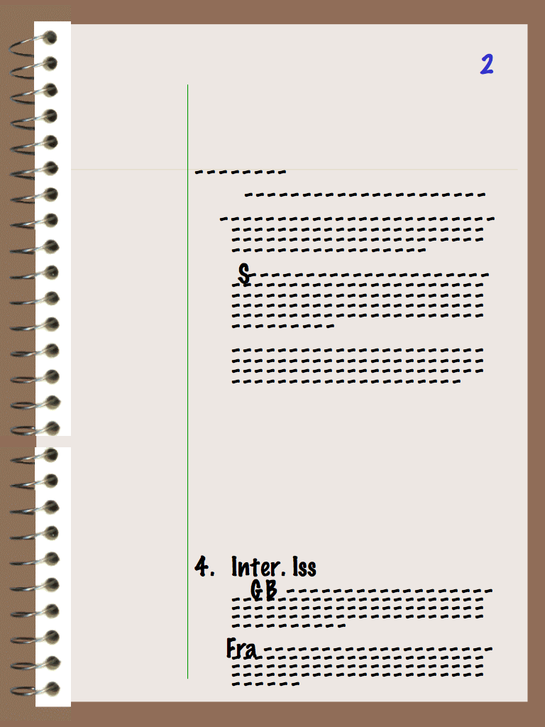

Slide 16
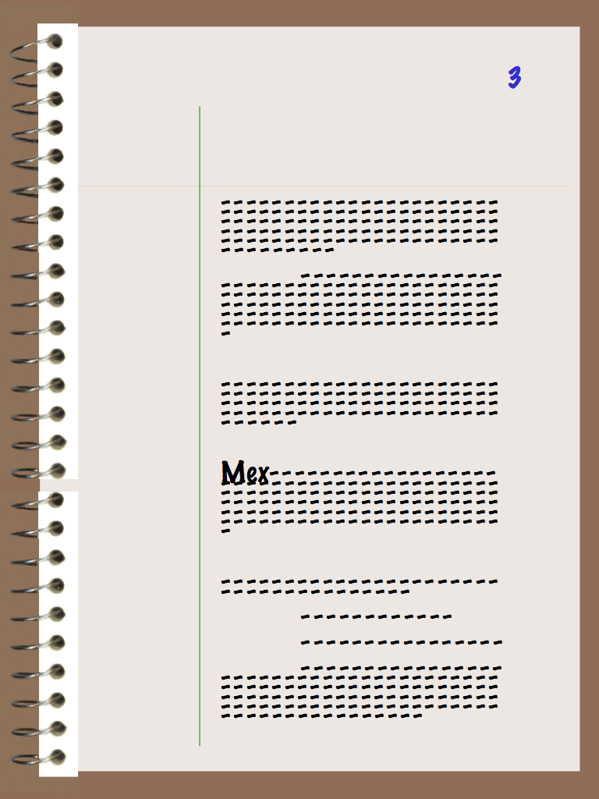

Slide 17
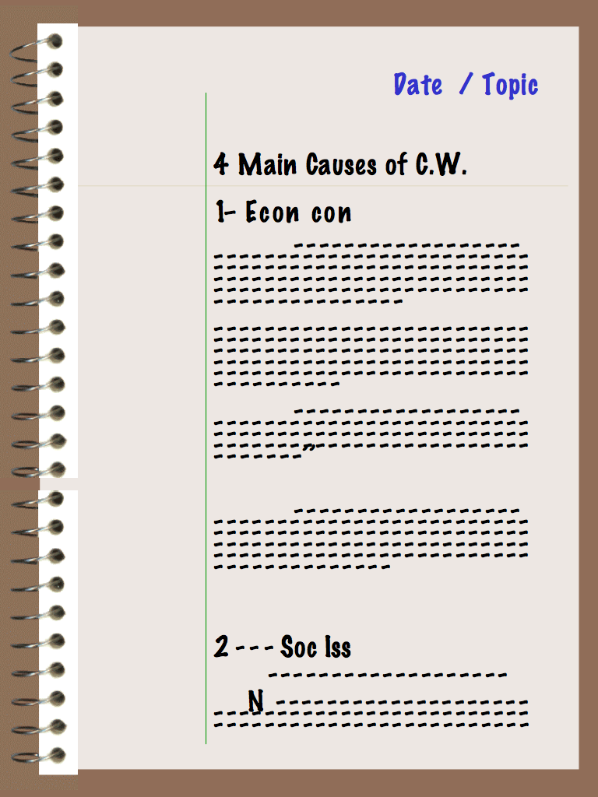

Slide 18
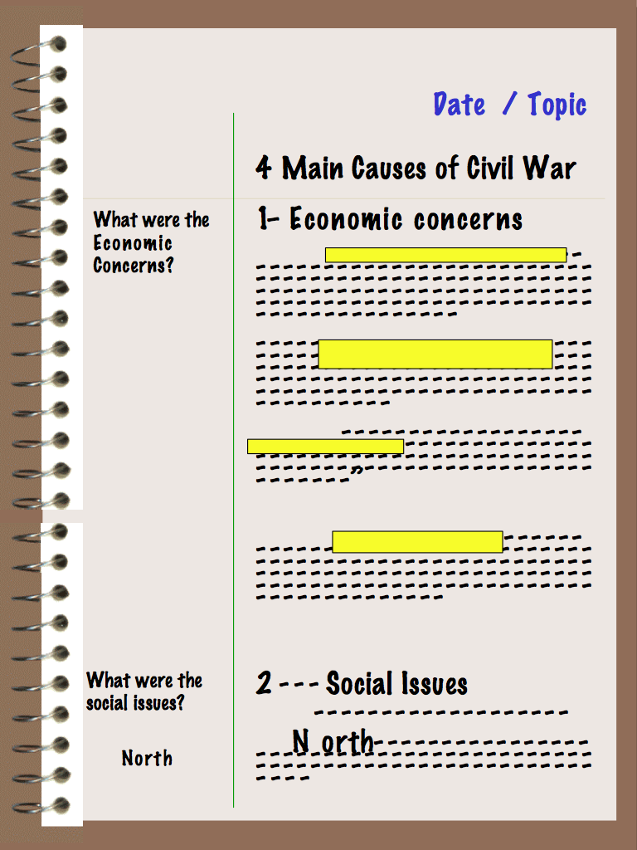

Slide 19
Benefits of Cornell Notes
Your notes are organized
You review your notes every day
You can quickly and easily identify key terms and concepts.
Your lecture notes become a study guide to help you prepare for the exam.

Slide 20
Try the Cornell Method of taking notes for a few weeks and notice the difference!
You don’t have to be a genius to take good notes. All that you need is a good work ethic and consistency.

